Slide 1
UI Design & ‘Figma’
Prototyping Tool
CSE 3412

Slide 2
Lab Schedule
Week | Discussion | Marks
1 | Introduction
2 | Lecture on Benchmark Analysis and Feasibility Studies + Group Finalization
3 | Presentation - 1 (Proposal + Benchmark Analysis) | 10
4 | Lecture on UI Design and prototyping tool (Figma)
5 | Presentation - 2 (Feasibility Studies) | 10
6 | Lecture on Project Management Tools(JIRA) + Feature Finalization
7 | Presentation - 3 (JIRA + Full Prototype) | 15
8 | Presentation - 4 (Project Progress 25%) | 10
9 | Presentation - 5 (Project Progress 50%) | 10
10 | Lecture on Testing, Deployment & Maintenance (Github, InfinityFree)
11 | Presentation - 6 (Project Progress 75%) + Testing | 15
12 | Presentation - 7 (Final Project Update 100%) + Report Submission | 15

Slide 3
How To Design A Good UI?

Slide 4
UI Design Considerations : Usability
Learnability
How easy is it to learn ?
Efficiency
Once learned, is it fast to use?
Safety
Are errors few and recoverable?

Slide 5

Relative importance of usability dimensions
Depends on the user
ꟷNovices need learnability.
ꟷ Experts need efficiency.
ꟷBut no user is uniformly a novice or an expert.
Depends on the task
ꟷMissile launchers need safety.
ꟷ Electronic doors need efficiency.

Slide 6

Usability matters: the cost of getting it wrong
50% of all “malfunctioning” electronic devices returned to stores are in full working order, but users can't figure out how to operate them.
[Elke den Ouden, 2006]
Three Mile Island: nuclear reactor meltdown caused by an ambiguous user interface

Slide 7
A good user interface is hard to design …
You are not the user
Most software engineering is about
communicating with other programmers.
UI is about communicating with users.
Users are always right …
Consistent problems are the system’s fault.
Except when they aren’t
Users don’t always know what they want.
UI accounts for 50% of
design, implementation,
and maintenance time
lines of code

Slide 8
Achieving usability: best practices
User testing and field studies
Evaluations and reviews by UI experts
Prototyping
ꟷ Cheap, throw-away implementations
ꟷ Low-fidelity: paper prototypes
ꟷMedium-fidelity: code prototypes
Key to success: good UI focuses on the user, not the developer or the system.

Slide 9
What is prototyping? Why do it?
Prototyping: creating a scaled-down or incomplete version of a system to demonstrate or test its aspects.
Benefits of prototyping:
ꟷaids UI design
ꟷhelp discover requirements
ꟷhelp discover test cases and provide a basis for testing
ꟷallows interaction with user to ensure satisfaction
ꟷteam-building

Slide 10
Some prototyping methods
Code prototyping
ꟷimplement a "quick" / incomplete version of a UI
Prototyping with UI builders (e.g., Visual Studio)
ꟷdraw a GUI by dragging/dropping UI controls on screen
Paper prototyping
ꟷa paper version of a UI

Slide 11
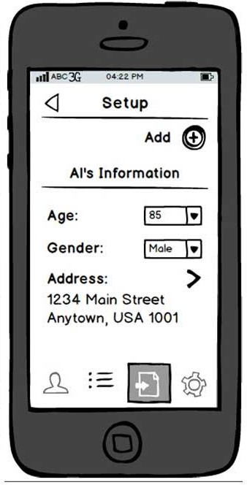
Why paper prototyping?
Much faster to create and change than code
More visual bandwidth (can see more at once)
More conducive to working in teams
Can be done by non-technical people
Feels less permanent or final

Slide 12
When to do prototyping?
During or after requirements but before design
ꟷhelps uncover requirements and upcoming design issues
ꟷshows us what is in the UI, but also shows us details of how the user can achieve goals in the UI

Slide 13
UI Design Considerations

Slide 14
Theo Mandel's 3 Golden Rules

Slide 15
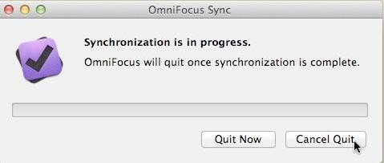
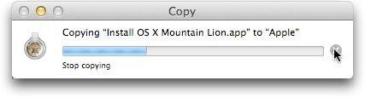
Rule 1: Place the user in control.
Experienced operators strongly desire the sense that they are in charge of the system and that the system responds to their actions. Design the system to make users the initiators of actions rather than the responders.

Slide 16
Rule 1- (design principles) : Place the user in control.
Define interaction models in a way that does not force a user into unnecessary or undesired actions.
Provide for flexible interaction.
Allow user interaction to be interruptible and undoable.
Streamline interaction as skill levels advance and allow the interaction to be customized.
Hide technical internals from the casual user.
Design for direct interaction with objects that appear on the screen.

Slide 17
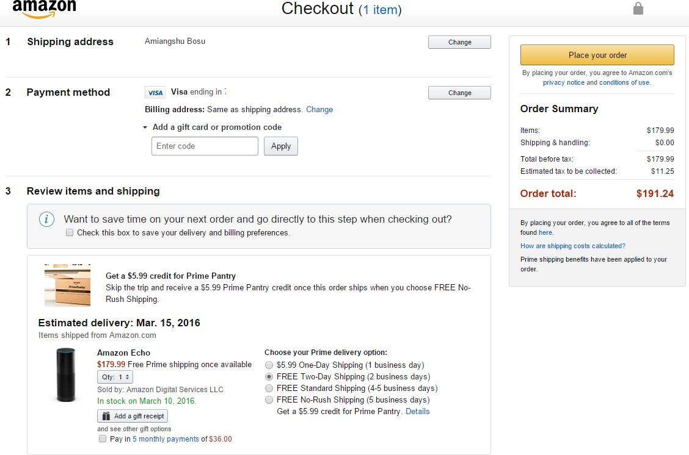
Rule 2: Reduce the User’s Memory Load
The limitation of human information processing in short-term memory requires that displays be kept simple, multiple page displays be consolidated, window-motion
frequency be reduced, and
sufficient training time be allotted
for codes, mnemonics, and
sequences of actions.

Slide 18
Rule 2- (design principles) : Reduce the User’s Memory Load
Reduce demand on short-term memory.
Establish meaningful defaults.
Define shortcuts that are intuitive.
The visual layout of the interface should be based on a real- world metaphor.
Disclose information in a progressive fashion.

Slide 19
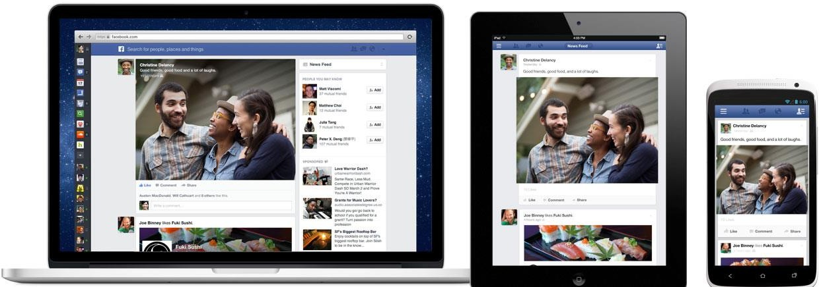
Rule 3: Make the Interface Consistent
Consistent sequences of actions should be required in similar situations; identical terminology should be used in prompts, menus, and help screens; and consistent commands should be employed throughout.

Slide 20
Rule 3 – (design principles) : Make the Interface Consistent
Allow the user to put the current task into a meaningful context.
Maintain consistency across a family of applications.
If past interactive models have created user expectations, do not make changes unless there is a compelling reason to do so.

Slide 21
Let’s take a break.

Slide 22
Prototyping Tool: FIGMA demo

Slide 23
Thank You

